Slide 1

My Bank-Deposits Module
Revenue Rulers
-Akshira

Slide 2
Module Description
The Deposits Module is an integral part of MY Bank's banking system, facilitating management of both available deposits and deposits availed by customers. It encompasses functionalities related to the creation, management, and retrieval of deposit information, including details such as deposit ID, deposit amount, tenure, return of interest (ROI), deposit type, and description.
Key Features:
1. Deposit Available Management:. - Stores information about available deposits, including deposit ID, deposit amount, ROI, deposit type, and description. - Provides functionalities to search for available deposits based on deposit ID.
2. Deposit Availed Management: - Facilitates management of deposits availed by customers. - Stores information about deposits availed, including deposit ID, deposit amount, tenure, maturity, customer ID, and deposit ID. - Supports functionalities to create, update deposit availed records.
3. Search Functionality: - Enables users to search for available deposits based on deposit ID. - Retrieves deposit information from the database based on the provided deposit ID.
4. Calculator Service: - Provides a service for calculating the maturity deposit amount based on deposit amount, tenure, and return of interest. - Utilizes the simple interest formula: Maturity Amount = Principal Amount + (Principal Amount * Rate * Time).
Overall, the Deposits Module serves as a comprehensive solution for managing both available deposits and deposits availed, offering functionalities for retrieval, manipulation, and calculation of deposit-related information within MY Bank's banking system.

Slide 3
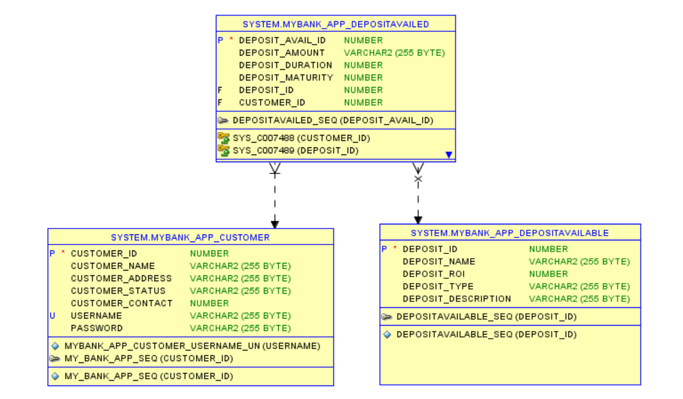
ER Diagram

Slide 4
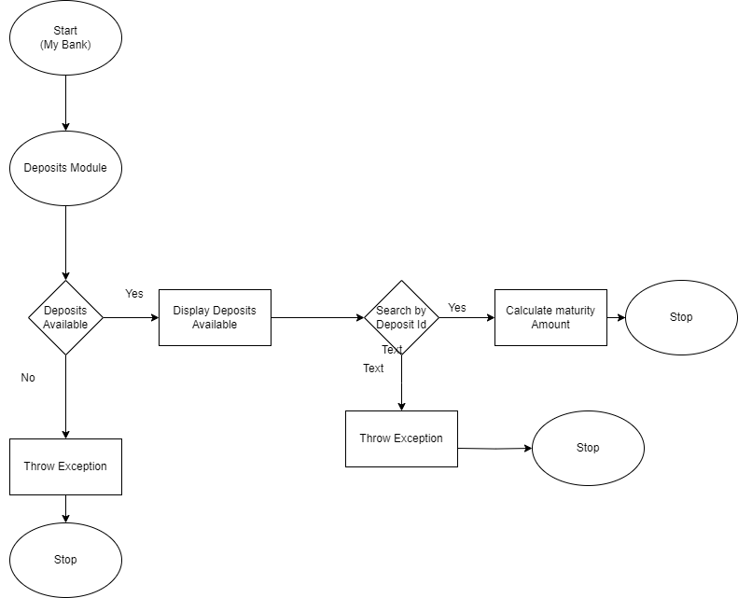
Flowchart

Slide 5
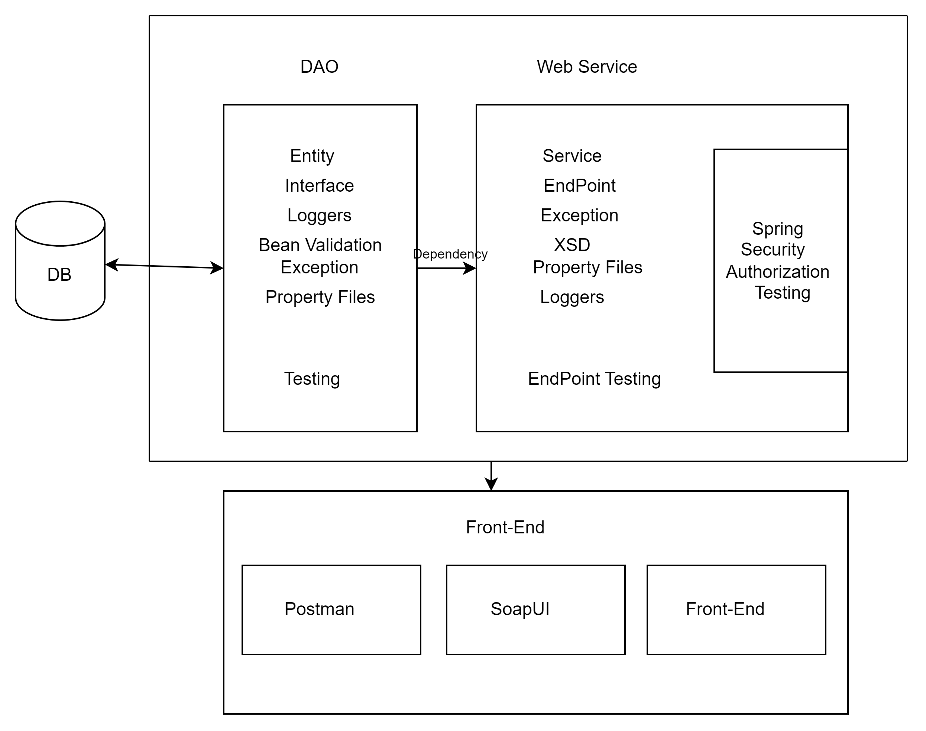
Architecture Diagram

Slide 6
Jar File mybankdeposit-0.0.1-SNAPSHOT.jar
Github Link
https://github.com/Akshirahegde/DLTE-JAVA-FULL-STACK-AKSHIRA-2024/tree/master/DLTE-MYBANK-PROJECT

Slide 7
THANK YOU

